Slide 1
Ethnic Differences in Phonetic Production
Ryan C McMurry
Sirmcmurry.github.io

Slide 2
Introduction
Are their phonetic production differences along ethnic lines?
If yes, do these differences show in vowel production?
How do these differences pattern along current vowel shifts?

Slide 3
Caveats
What I do not have time to discuss
Definition of Ethnicity
Ethnicity is a very fluid human construction
No two people will have the exact same ethnic expression
Despite this there are general patterns that can be found
Social Identity Theory and social significance and meaning (Hogg, 2016)
This meaning is conveyed by shared conventions (Ochs, 1993)
Conventions are shared by concrete sounds (Eckert & Labov, 2017)
Phonetic NOT Phonemic
I am looking at this from a phonetic lens

Slide 4
Previous Work
Vowel differences along ethnic lines
Variation of Northern City Shift (Gordon, 2000)
Raising of /æ/ was not seen in African and Mexican American population
Raising of /ɛ/ was not seen in the African and Mexican American population
White Americans appeared to lead the shift

Slide 5
Previous Work (cont.)
Vowel differences along ethnic lines
Variation in San Francisco (Cardoso et al. 2016)
Differences in nasality in /æ/
Chinese Americans showed less nasality in words like BAN
White Americans generally produced more nasality

Slide 6
Current Study
Will I find vowel differences from the students at UC Davis?
22 participants (18-20 yo)
12 East Asian (ethnically descendant of Japanese, Chinese, and Philippine peoples)
10 White (ethnically descendant of European peoples)
From California
HvD, BvD, BvT, Pen/Pin, two diphthongs, pull/pool

Slide 7
Low Back Merger (LBM)
Merger throughout North America of merging of /ɔ/ and /ɑ/ vowels (Doernberger & Cerny, 2008)
COT and CAUGHT
California
fronting of /u/ and the lowering of /I/ and /ɛ/
raising of /æ/ in some contexts

Slide 8
Method
Participants were recorded using Praat (44100 hertz)
Annotated the wav files and aligned using DARLA (Dartmouth Linguistic Automation)
Extracted the vowels using FastTrack (Barreda, 2021)
Normalized the vowels using log-mean normalization (Barreda & Nearey, 2018)

Slide 9
Method (Cont.)
Linear Discriminant Analysis & Signal Detection Theory Analysis
LDA: Can a model to be trained to the formants of each ethnicity?
Predictions could suggest where in the vowel space each ethnicity produces the vowel
SDT: How accurate and reliable is that model?
What is the hit rate and false alarm rate?

Slide 10
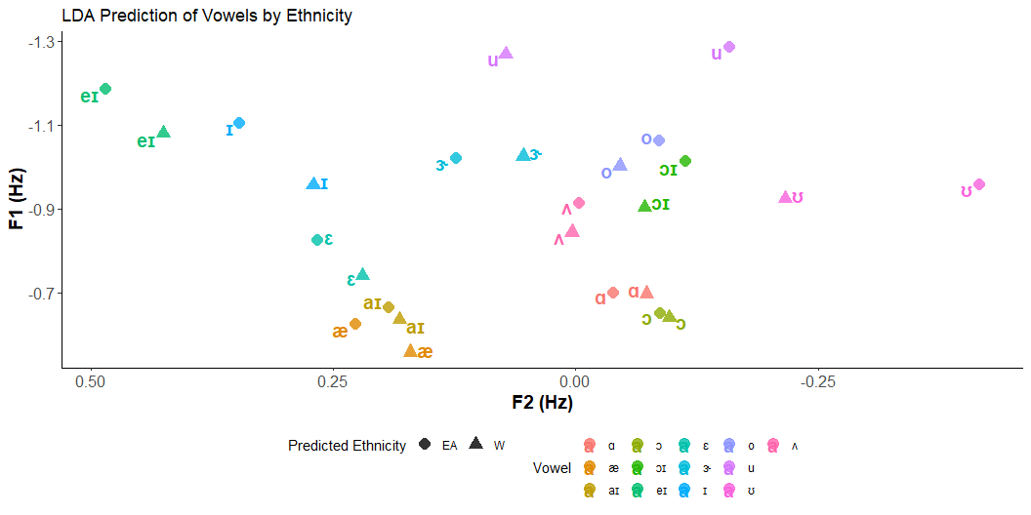
LDA Predictions
lda_model <- lda(vowel_ethnicity ~ f11-f15+f21-f25+f31-f35)
Divide the vowel space into 3
Front Vowels
Differ in terms of “height”
The most dramatic /eI/ and /I/ while /ɛ/ is less so
Mid Vowels
Difficult to generalize a pattern
Perhaps /ɝ/ is different
Vowels may have great overlap in production
Back Vowels
Differ in terms of “frontness”
/u/ and /ʊ/ strikingly different

Slide 11
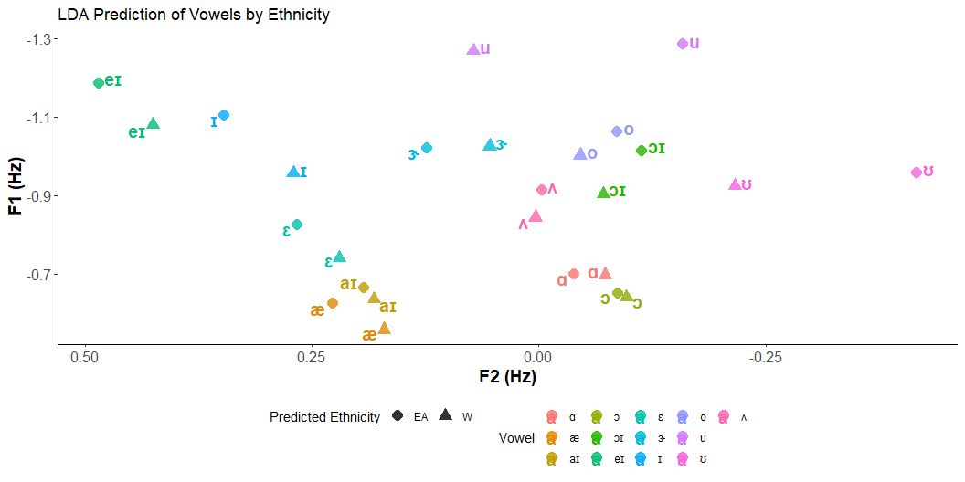
LBM Context
Low back vowels are merged (how surprising)
Differences in the fronting /u/ and /ʊ/
The White population follows this trend more
Differences in /ɪ/, and /ɛ/ lowering
“Higher” in the EA population
The W population follows this trend more

Slide 12
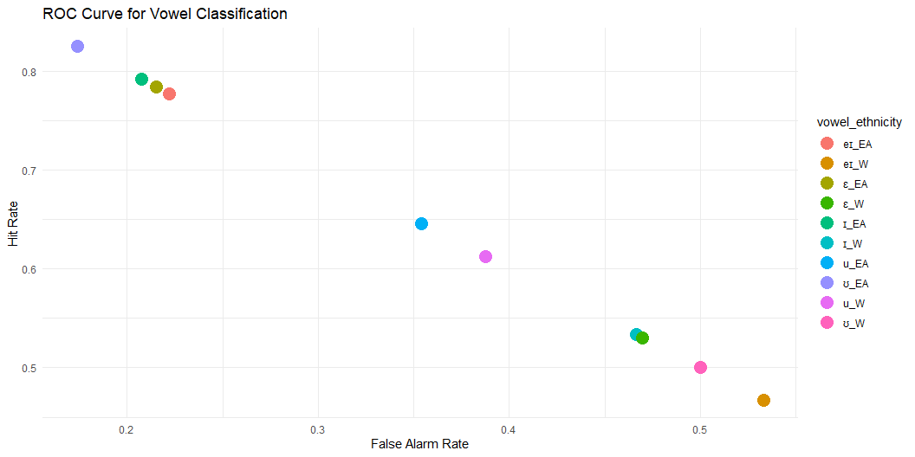
SDT Analysis
Front Vowels
/eɪ/ in the White population low hit rate /eɪ/ high rate
/ɛ/ high hit rate in both populations
/ɪ/ high hit rate in both populations
Back Vowels
/ʊ/ fifty-fifty split in the W population high in the EA population
/u/ high hit rate in both populations
Can we trust these results?

Slide 13
SDT Analysis (Cont.)
Yes, and
Overall d’ Values (sensitivity) relatively moderate ~1.5
Suggest the mode is able to properly discriminate between the two ethnicities
However, some overlap does exist
Lower d’ Values in the W population
d’ for the /ɪ/ vowel in the White population only .16
d’ for the /u/ vowel in both populations only .75 and .57 (EA & W)
Perhaps there is more overlap within groups then between?

Slide 14
Thoughts
Production differences appear to exist
Front vowels
Predicted to be higher in the EA population than the W
Back vowels
Predicted to be more fronted in the W population than the EA
Intra-group Variation
d’ values overall lower in the EA population
Possible evidence of greater variation in the W population

Slide 15
Conclusion
MORE DATA!
In order to increase accuracy and raise d’ values

Slide 16
Thank you

